Slide 1


Online Travel Guide using AI
A User-Friendly Web Application for Efficient Trip Planning
Batch 2:
1.Miriyala.Bindu Sravanthi
2. Manish
3.Vemula.Sushma
4.Lavanya
5.Loga Krishna

Slide 2
Abstract
Overview: The Online Travel Guide using AI project is designed to assist tourists in planning trips by offering personalized recommendations, voice-based interaction, and optimized route planning. This AI-driven system ensures that users can explore tourist destinations with minimal effort and time by providing a seamless interface that caters to their preferences.
Key Features:
Voice recognition to display tourist places based on user input.
Booking management and place information display to help users manage their trip details efficiently.
Optimized routes based on the selected destinations, ensuring minimal travel time between locations.
User authentication for secure access and an admin dashboard for managing user data, places, and bookings.

Slide 3
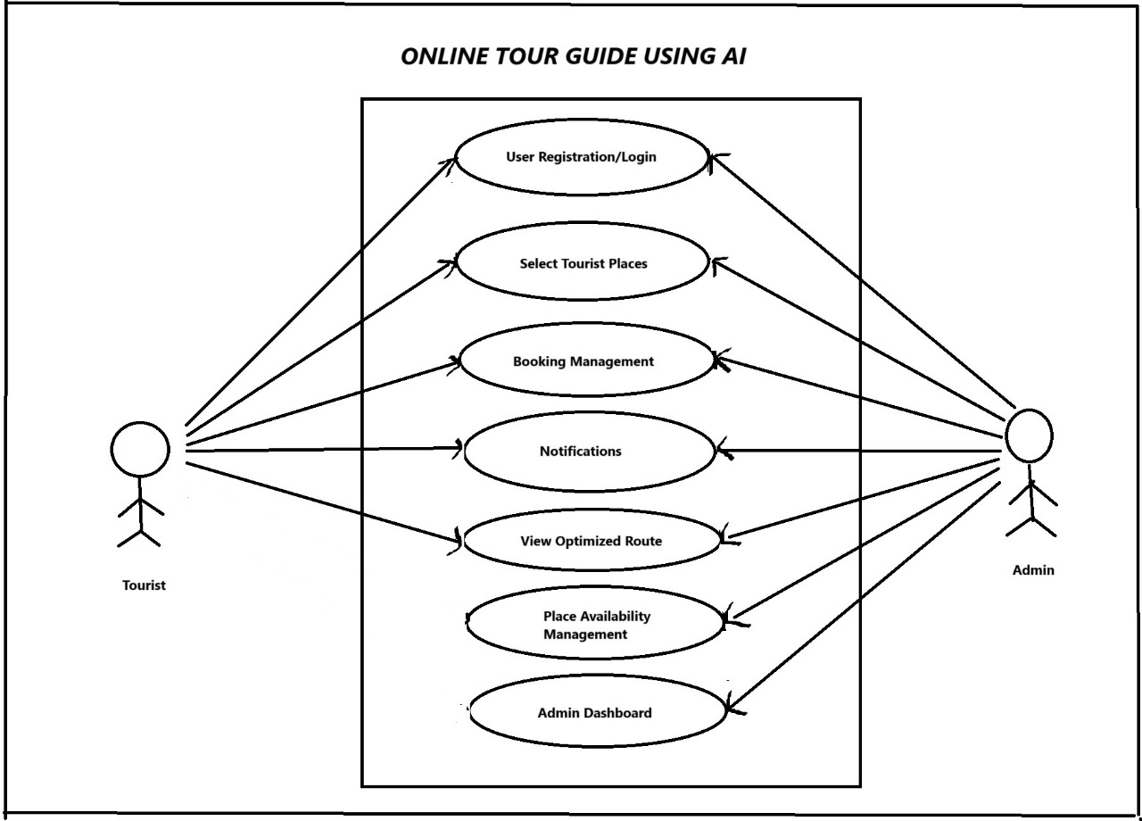
Use Case Diagram

Slide 4
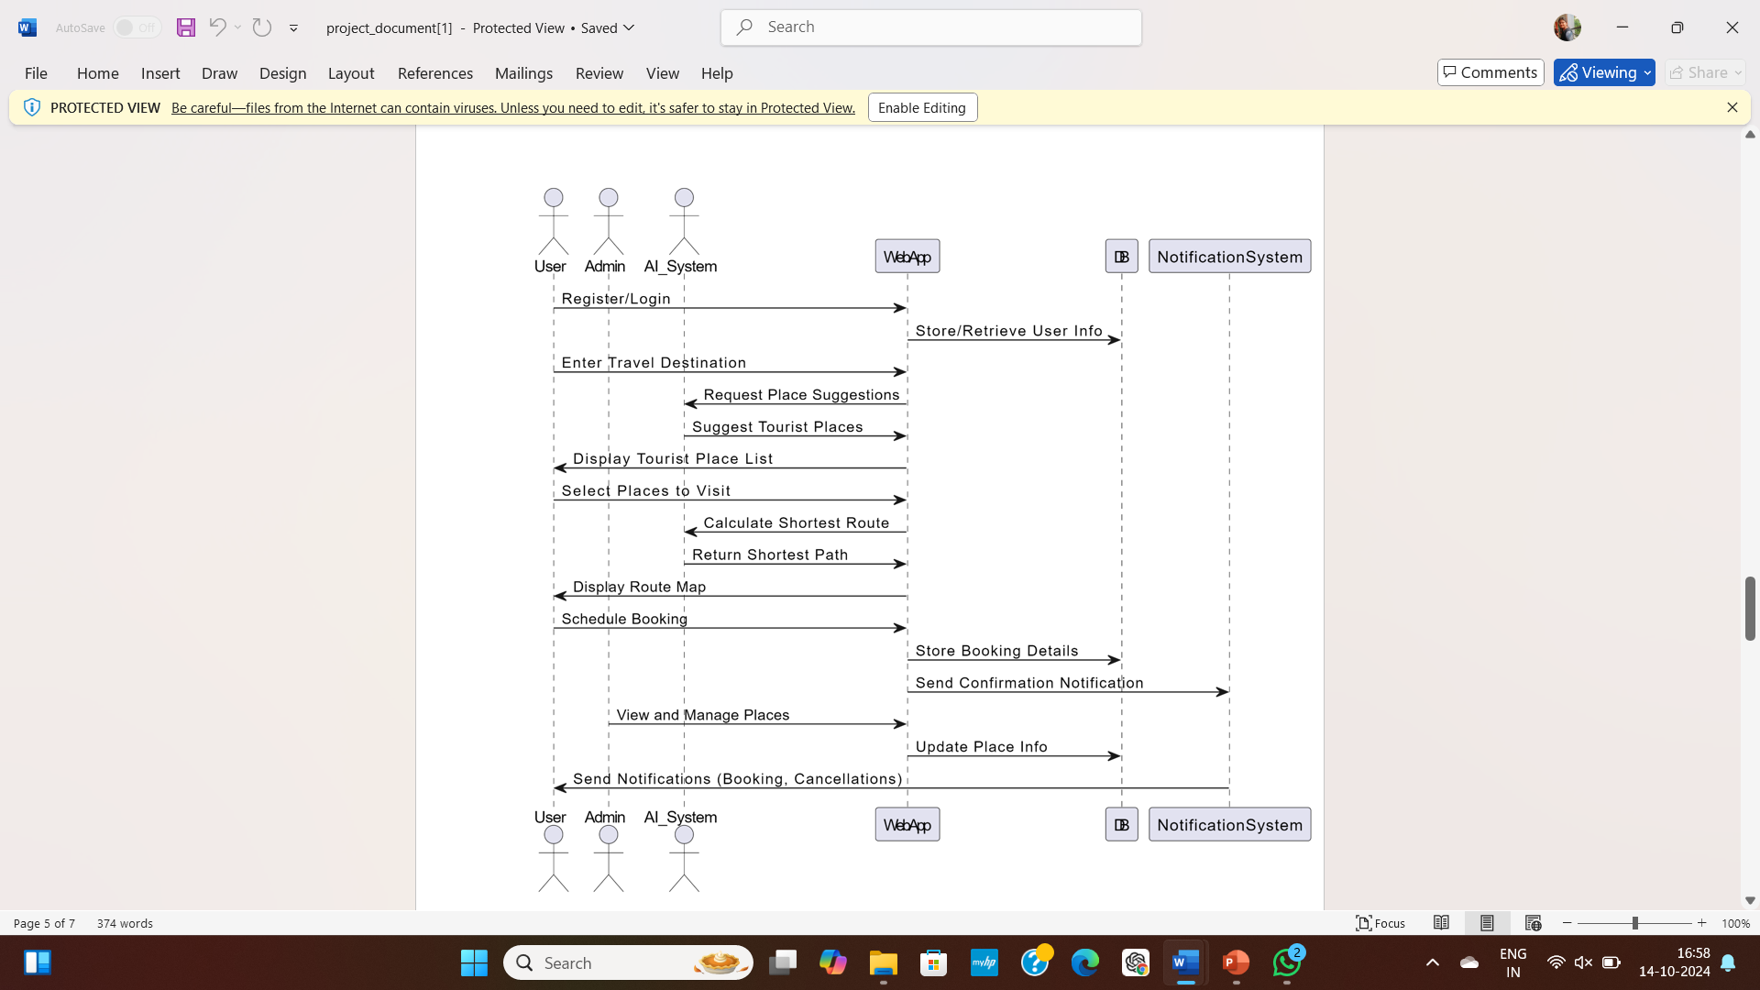
Sequence Diagram

Slide 5
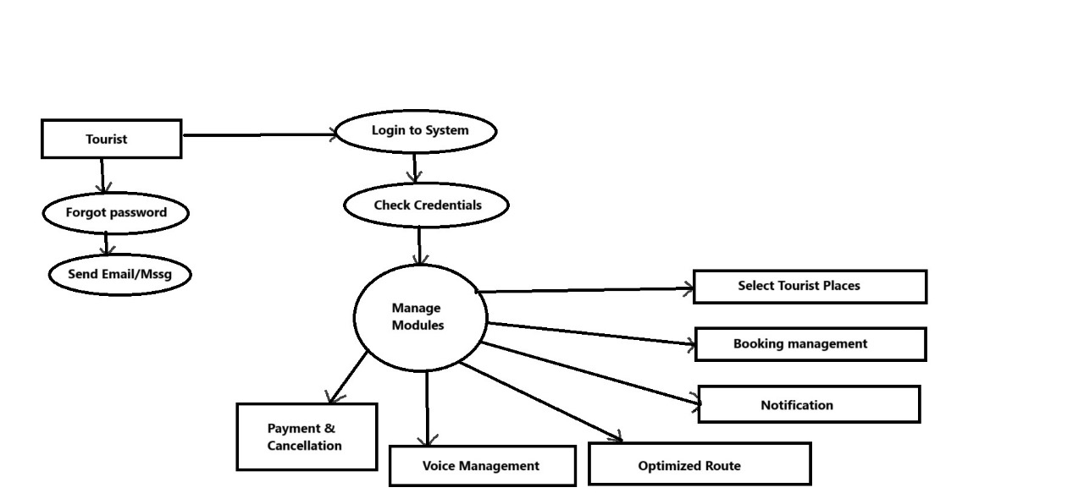
DFD for Tourist

Slide 6
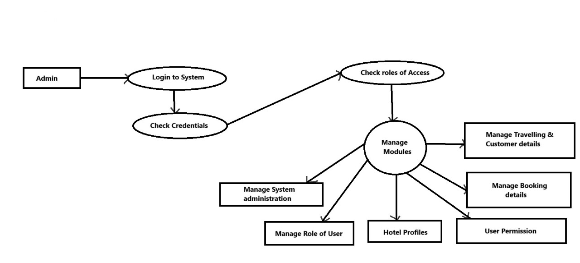
Dfd for admin

Slide 7
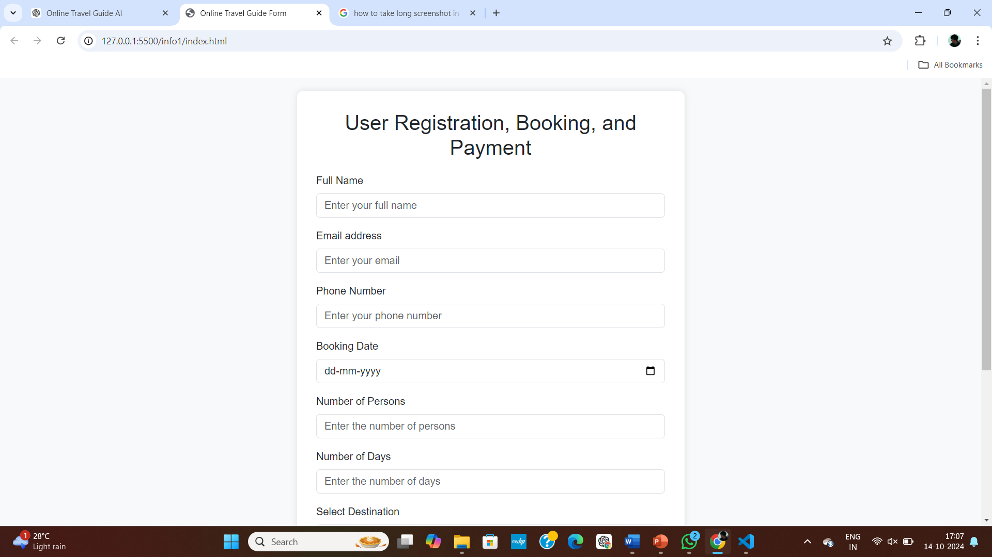
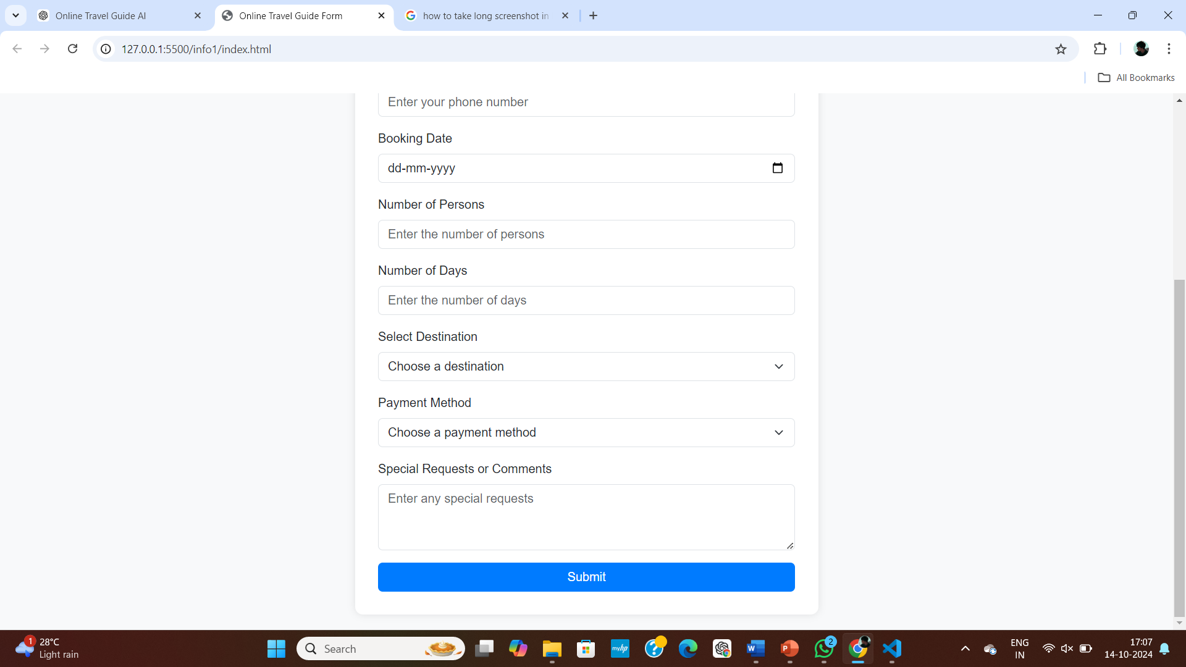
Form Design

Slide 8

Feature Enhancement
Fully Responsive Design: The website will be enhanced to adapt seamlessly to all screen sizes and devices, providing an optimal user experience across desktops, tablets, and smartphones.
Hotel Booking Integration: Users can search book hotels directly from the platform.
Review and Rating System: Allow users to see reviews and rate hotels, tourist places, and services, offering a comprehensive feedback system.
Pricing Alerts: Displaying prices helping users to book more cost-effectively.

Slide 9

Conclusion
This project is built with various modules including user authentication, booking management, place availability management, and an admin dashboard
By taking into account the start and end points of the tour and using advanced algorithm, the application creates an optimal result with the shortest possible routes.
Users can easily register and log in to the system, browse tourist locations, and manage bookings—all while receiving notifications and real-time updates.
The application is highly beneficial for tourists exploring unfamiliar locations, as it saves valuable time in navigating between attractions. It not only helps users discover the best places to visit but also ensures that their trips are well-organized and hassle-free.
In summary, the Online Travel Guide using AI revolutionizes the way tourists plan their trips by offering a personalized, efficient, and intelligent travel experience.

